Slide 1
IS216 Web Application Development II
Week 4
JavaScript – Part 2 (DOM & Event Handling)
K. J. Shim
Sections: G3/G4
https://tinyurl.com/is216-krazy-2024-js-part2

Slide 2

Source Code Files
eLearn → Content → Week 4 → Before Class → Week4.zip
Unzip it into your webroot (any meaningful sub-directory), for example:
(WAMP) C:\wamp64\www\is216\...\Week4
(MAMP) /Applications/MAMP/htdocs/is216/…/Week4
Visit web pages (.html) via HTTP protocol
Do NOT double-click on the HTML file. Your computer will open the HTML file as a file.
→ OH NO…
Open web pages via HTTP protocol. How? Go to the web browser’s address bar
→ GOOD

Slide 3
Agenda
Introduction to DOM
Event Handling – onclick event
Accessing HTML Elements
Accessing HTML Attributes
Modifying HTML
Adding and Removing HTML Elements
More event handling
Dynamic Web app
===
Whenever some event occurs, change the HTML document.

Slide 4
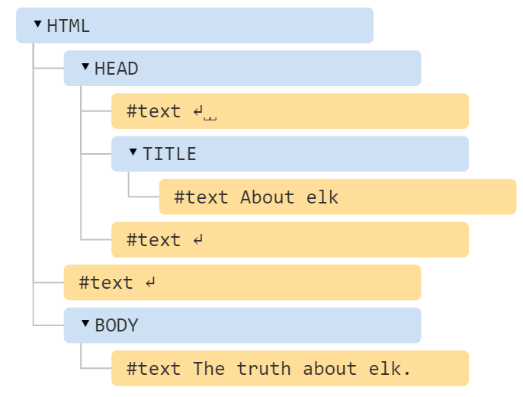
What is DOM?
<!DOCTYPE HTML>
<html>
<head>
<title>About elk</title>
</head>
<body>
The truth about elk.
</body>
</html>
The browser represents an HTML document as Document Object Model (DOM).
In DOM, every HTML entities – elements, attributes, texts are represented as nodes (objects) in a hierarchical data structure.
This data structure makes it easy for JavaScript to access and change the entities in an HTML document.
With DOM, we can access and modify the HTML document through Javascript.

Slide 5
What is DOM?
Reference
Document Object Model (DOM) - Web APIs | MDN
Important Concepts
Document: an interface represents any web page loaded in the browser.
Node: an abstract base class upon which many other DOM API objects are based.
Element: the most general base class from which all element objects (i.e. objects that represent elements).
Event: an interface represents an event which takes place in the DOM.
Node is more general than Element

Slide 6
Event Handling
JavaScript can be used to listen to events and react (by changing the tree nodes) based on what the user does.
Events such as
Clicking a mouse
Hovering over an image
Typing something in a search bar
Examples: wk4example1.html
<p id="time"></p>
<button onclick="document.getElementById('time').innerHTML= Date()"> What time is it? </button>
Be mindful of using innerHTML as it’s known to cause XSS problem
Avoid assigning it with values directly read from user inputs
Use innerText instead whenever possible

Slide 7
Events
Events reference: Event reference | MDN
Event | Description
onclick | The user clicks an HTML element
onchange | An HTML element has been changed
oninput | The user inputs something in an HTML element
onmouseover | The user moves the mouse over an HTML element
onmouseout | The user moves the mouse away from an HTML element
onkeypress | The user presses a key on the keyboard
onload | The browser has finished loading the page

Slide 8
DOM Manipulation
Manipulating the DOM, JavaScript can create dynamic HTML
change all the HTML elements, attributes, and CSS styles in the page
change all the HTML elements, attributes, and CSS styles in the page
remove existing HTML elements and attributes
add new HTML elements and attributes
react to HTML events in the page
create new HTML events in the page
Examples: wk4example1.html
<p id="time"></p>
<button onclick= "document.getElementById('time').innerHTML= Date()">What time is it? </button>
In this example, we change one HTML element in the page.
You can do whatever you want to the tree.

Slide 9
Access HTML Elements
Through ID
document.getElementById(“id”)
Returns the unique element which is associated with the provided ID.
Example
<p id="hello"></p>
<p id="hello"></p>
<script> document.getElementById("hello").innerHTML = "Hello World!";
</script>
What happens then?

Slide 10
Access HTML Elements
Through class name
document.getElementsByClassName("name")
Returns an “array” of all elements which are associated with the given class name(s).
Example: wk4example1.html
<p class="hello">To be updated</p>
<p class="hello">To be updated</p>
<button onclick= "sayHello()">Say Hello </button>
<script>
function sayHello() {
var x = document.getElementsByClassName("hello");
for (ele of x) {
ele.innerHTML = '<p>Hello~~~</p>';
}
}
</script>

Slide 11
Access HTML Elements
Through class name
element.getElementsByClassName("name")
You may also call getElementsByClassName() on any element; it will return only elements which are descendants of the specified root element with the given class name(s).
Examples
var x = document.getElementById("div1");
var y = x.getElementsByClassName("p");
The following finds the element with id="div1", and then finds all <p> elements inside "div1".

Slide 12
Access HTML Elements
Through tag name
getElementsByTagName("name")
returns a live HTMLCollection of elements with the given tag name.
*** “live” means that the collection changes if it so happens that elements are being updated
Examples
First Name: <input name="fname" type="text" >
Last Name: <input name="lname" type="text” >
<p id="name"></p>
<script>
var n = document.getElementsByTagName("input")[0].value;
document.getElementById("name").innerHTML = n;
</script>
Notes:
Get the <input> elements and access the value of the first <input> element:

Slide 13
Access HTML Elements
Through tag name
getElementsByTagName("name")
returns a live HTMLCollection of elements with the given tag name.
Examples: wk4example2.html
<a href="ex1.html">ex1</a>
<a href="ex2.html">ex2</a>
<a href="ex3.html">ex3</a>
<script>
var nodes = document.getElementsByTagName("a");
for (node of nodes) {
console.log(node); // log the same <a> list above
}
</script>

Slide 14
Access Properties
Properties
Use .value, .type, .id, .name and so on to access various properties of an input element
Example
wk4example3.html

Slide 15
Access Properties
Properties
Use document.forms to access various forms.
Example
wk4example4.html

Slide 16
Access Attributes
Attributes
Use node.getAttribute(“something”) to access attributes.
Example
wk4example5.html

Slide 17
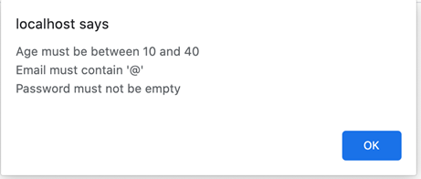
Exercise 1
Given ex1.html which contains a form for multiple user inputs, write form validation code that checks:
ID has a maximum length of 10 characters
Email contains the character ‘@’
Minimum age = 10, Maximum age = 40
Password field is non-empty

Slide 18
Modifying Content
Two options to modify the content of HTML elements like <h1>, <p>, <div>.
innerText retrieves and sets the content of the tag as plain text (safer way)
innerHTML retrieves and sets the content in HTML format (no encoding and can include HTML tags, which may cause XSS problems if untrusted user inputs are used)
Examples: wk4example6.html
<div id="div">Hi…</h1>
<script>
var element = document.getElementById("div");
element.innerText = "Hello there…";
</script>

Slide 19
Modifying Attributes
Modifying attributes by setting its values.
Example:
wk4example7.html

Slide 20
Modifying Style
Syntax
document.getElementById(id).style.property = new style
Example:
<p id="para">Hello Style!</p>
<script>
document.getElementById("para").style.color = "red";
</script>

Slide 21
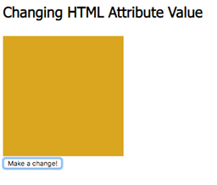
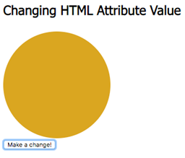
Exercise 2
Given that ex2.html initially shows a square box as shown in the figure below.
Add CSS and Javascript code in ex2.html so that:
When the button is clicked, the page shows a circle
And when the button is clicked again, the page shows a square

Slide 22
Add Elements
JavaScript can create dynamic HTML content
The write() method writes HTML expressions or JavaScript code to a document.
The write() method is mostly used for testing: If it is used after an HTML document is fully loaded, it will delete all existing HTML.
Example: wk4example8.html
<!DOCTYPE html>
<html>
<body>
<script>
document.write("<h2>Hello</h2>");
</script>
</body>
</html>
Like innerHTML, be mindful of using write() as it’s also a dangerous method known to cause XSS problem

Slide 23
Add Elements
Create the element first and then append it to an existing element (e.g. <div>).
Example:
wk4example9.html

Slide 24
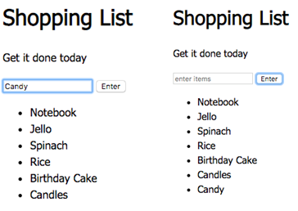
Exercise 3
Add HTML and JavaScript code ian ex3.html such that when a user enters a new item in the input field and clicks “Enter” button, the new item should be added into the existing list as shown below.
Assume that the user may be an evil. That is, do not use .innerHTML

Slide 25
Remove Elements
Get the element node and use remove()
Example
<div id="div1">
<p id="p1">This is a paragraph.</p>
<p id="p2">This is another paragraph.</p>
</div>
<script> document.getElementById("div1").lastElementChild.remove();
</script>

Slide 26
Exercise 4
Continue with exercise 3, add the following functionality.
Add a button next to each list item named “delete”
Delete the item when the corresponding delete button is clicked.
Hint: You can use “this” or something related as a parameter when you call the function associated with the delete button (to identify the right item).

Slide 27
Event Handling
When an event occurs, all information about that event are stored in a type of object called event (e.g., the time that the event occurs, and the key that is pressed).
JavaScript can access this information (i.e., the event object) and react to it accordingly.
Example: wk4example10.html & wk4example11.html
<button onclick="myFunc()">Click!</button>
<script>
function myFunc() { console.log(event);
}
</script>
Example: ExerciseSolutions → ex4.html
We can find out all the information of the event in the debugger.

Slide 28
Event Handling
More mouse events
onmouseover
onmouseout
onfocus
The MouseEvent
Example: wk4example12.html
<div onmouseover="mOver(this)" onmouseout="mOut(this)" >
Mouse Over Me
</div>
<script>
function mOver(obj) {
obj.innerHTML = "Thank You" } function mOut(obj) {
obj.innerHTML = "Mouse Over Me“
}
</script>
This refers to the containing node, i.e., the div node.
Notes:
true/false/true/false/error

Slide 29
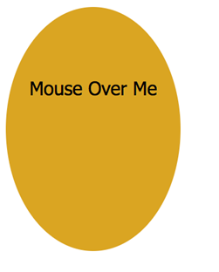
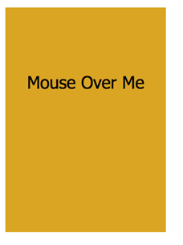
Exercise 5
Add code in ex5.html such that
the shape changes to square on mouse over event
And it changes back to circle on mouse out event.

Slide 30
Add Event Listener
Instead of adding event listeners in HTML codes (e.g., <button onclick="myFunc()">), JavaScript provides a way to listen to events all from JavaScript code.
Use addEventListener() method to attach an event handler to the element that you are interested in.
Examples
wk4example13.html

Slide 31
Add Event Listener
Instead of adding event listeners in HTML codes (e.g., <button onclick="myFunc()">), JavaScript provides a way to listen to events all from JavaScript code.
Use addEventListener() method to attach an event handler to the element that you are interested in
You can add many event handlers to one element. You can add many event handlers of the same type to one element, i.e., two "click" event handlers.
Examples
wk4example14.html

Slide 32
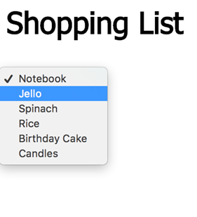
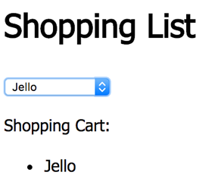
Exercise 6
Add code in ex6.html such that when an item is selected from the drop down list, the item is added into the shopping cart list as shown below. (Use addEvenetListener on the “change” event).

Slide 33
DOM: More Methods and Events
DOM Navigation:
https://www.w3schools.com/js/js_htmldom_navigation.asp
Events:
https://developer.mozilla.org/en-US/docs/Web/Events
Examples
// given focus to an element
document.getElementById("demo").focus();
// remove focus from an element
document.getElementById("demo").blur();

Slide 34
Take Away Message
To have a dynamic page, monitor events and change the DOM tree using Javascript.
Please be reminded to attempt Quiz 2 by this week.

Slide 35
Questions? Need Help?
Join us in Slack
@
https://is216-oppa.slack.com
Thank You!

